Slide 1

Heapsort

Slide 2
Heaps
A heap can be seen as a complete binary tree:
  What makes a binary tree complete?
  Is the example above complete?
16
14
10
8
7
9
3
2
4
1

Slide 3
Heaps
A heap can be seen as a complete binary tree:
  The book calls them “nearly complete” binary trees; can think of unfilled slots as null pointers
16
14
10
8
7
9
3
2
4
1
1
1
1
1
1

Slide 4
Heaps
In practice, heaps are usually implemented as arrays:
16
14
10
A =
16
14
10
8
7
9
3
2
4
1
=
8
7
9
3
2
4
1

Slide 5
Heap data structure
To represent a complete binary tree as an array:
  The root node is A[1]
  Node i is A[i]
  The parent of node i is A[i/2] (note: integer divide)
  The left child of node i is A[2i]
  The right child of node i is A[2i + 1]
16
14
10
A =
16
14
10
8
7
9
3
2
4
1
=
8
7
9
3
2
4
1

Slide 6
Referencing Heap Elements
So…
  Parent(i)
  return ⎣i/2⎦
  Left(i)
  return 2*i
  Right(i)
  return 2*i + 1

Slide 7
The Heap Property
Heaps also satisfy the heap property: (for max-heaps)
A[Parent(i)] ≥ A[i] for all nodes i > 1
  In other words, the value of a node is at most the value of its parent
  Where is the largest element in a heap stored?
Definitions:
  The height of a node in the tree = the number of edges on the longest downward path from node to a leaf
  The height of a tree/heap = ???

Slide 8
Heap Height
What is the height of an n-element heap? Why?

Slide 9
Heap Operations: Max-Heapify()
Max-Heapify(): maintain the heap property
  Given: a node i in the heap with children l and r
  Given: two subtrees rooted at l and r, assumed to be heaps
  Problem: The subtree rooted at i may violate the heap property (How?)
  Action: let the value of the parent node “float down” so subtree at i satisfies the heap property

Slide 10
Heap Operations: Max-Heapify()
Max-Heapify(A, i, n)
l = Left(i); r = Right(i);
if (l <= n and A[l] > A[i])
then largest = l
else
largest = i
if (r <= n and A[r] > A[largest])
then largest = r
if (largest ≠ i)
then Swap(A[ i], A[largest])
Max-Heapify(A, largest,n)

Slide 11
Max-Heapify() Example
16
4
10
14
7
9
3
2
8
1
A =
16
4
10
14
7
9
3
2
8
1

Slide 12
Max-Heapify() Example
16
4
10
14
7
9
3
2
8
1
A =
16
4
10
14
7
9
3
2
8
1

Slide 13
Max-Heapify() Example
16
4
10
14
7
9
3
2
8
1
A =
16
4
10
14
7
9
3
2
8
1

Slide 14
Max-Heapify() Example
16
14
10
4
7
9
3
2
8
1
A =
16
14
10
4
7
9
3
2
8
1

Slide 15
Max-Heapify() Example
16
14
10
4
7
9
3
2
8
1
A =
16
14
10
4
7
9
3
2
8
1

Slide 16
Max-Heapify() Example
16
14
10
4
7
9
3
2
8
1
A =
16
14
10
4
7
9
3
2
8
1

Slide 17
Max-Heapify() Example
16
14
10
8
7
9
3
2
4
1
A =
16
14
10
8
7
9
3
2
4
1

Slide 18
Max-Heapify() Example
16
14
10
8
7
9
3
2
4
1
A =
16
14
10
8
7
9
3
2
4
1

Slide 19
Max-Heapify() Example
16
14
10
8
7
9
3
2
4
1
A =
16
14
10
8
7
9
3
2
4
1

Slide 20
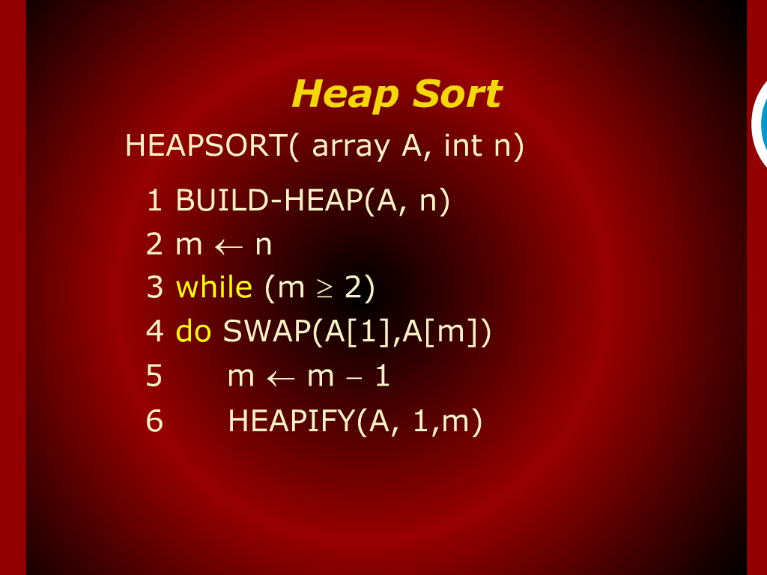
Heap sort Trace

Slide 21
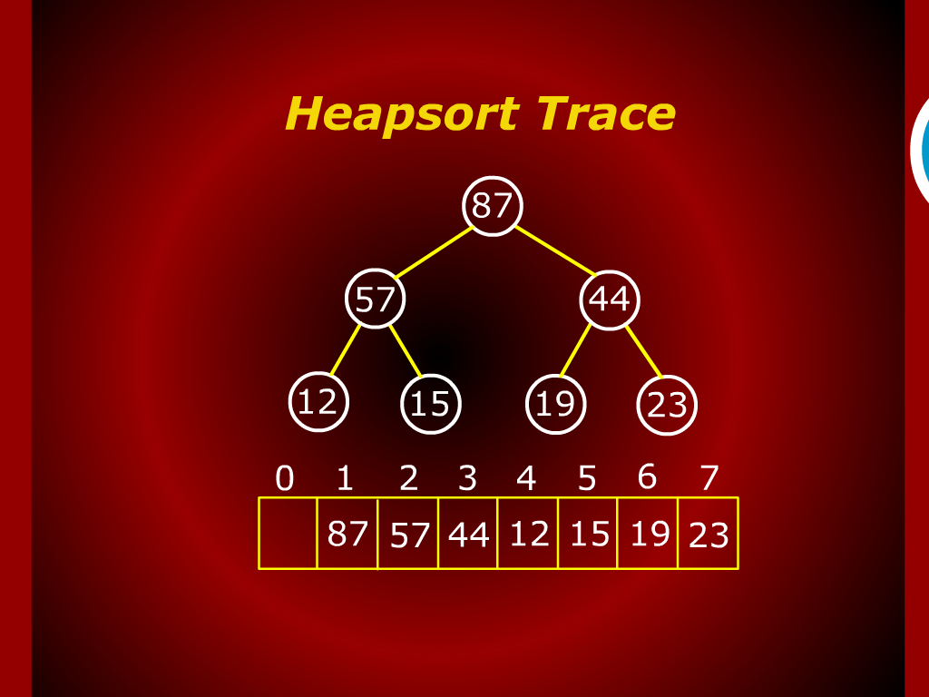
Heap sort Trace

Slide 22
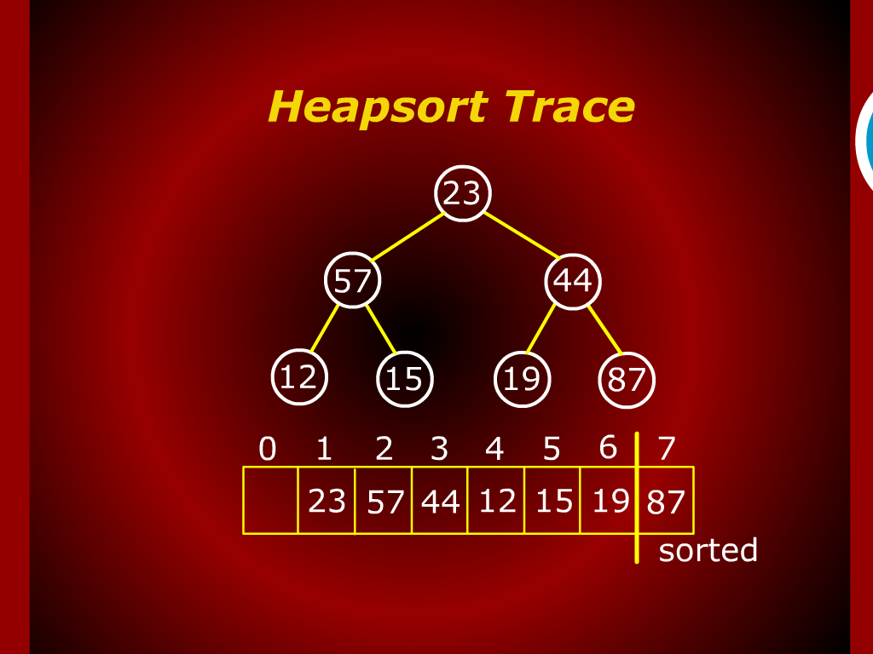
Heap sort Trace

Slide 23
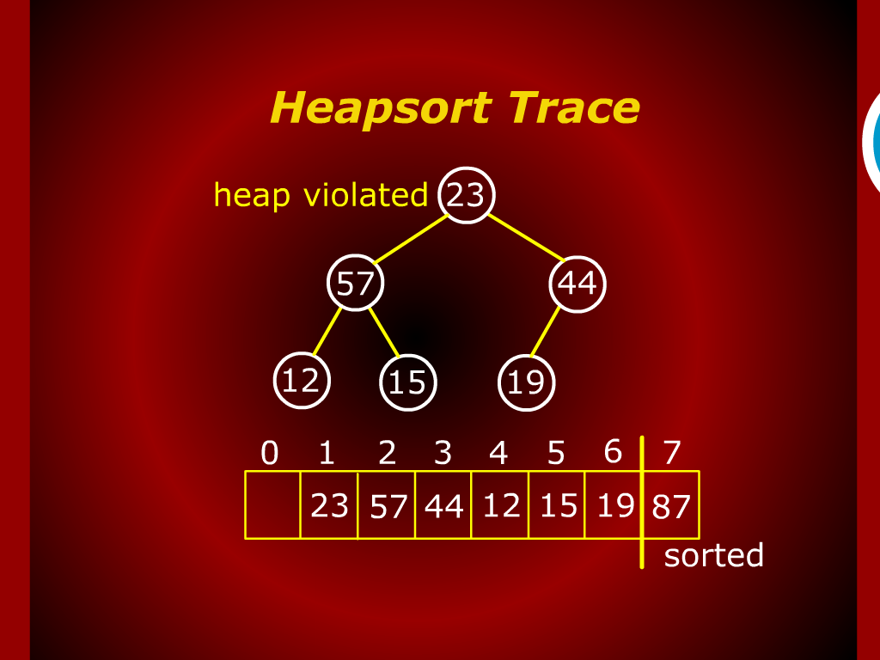
Heap sort Trace

Slide 24
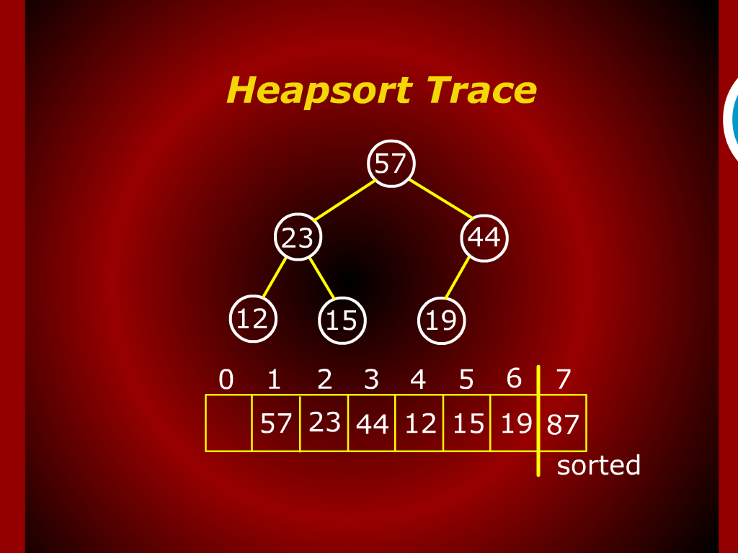
Heap sort Trace

Slide 25
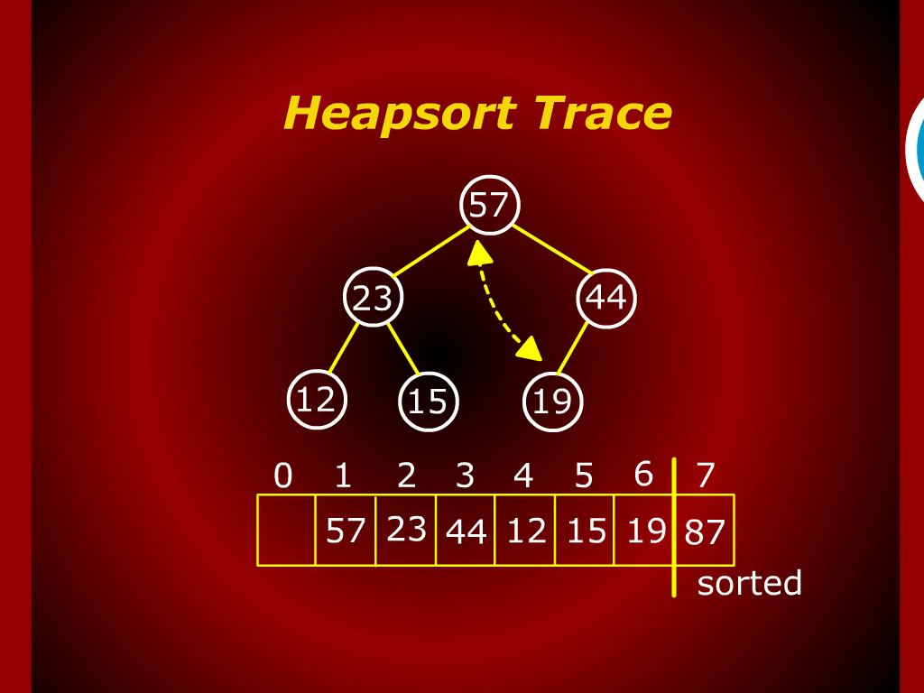
Heap sort Trace

Slide 26
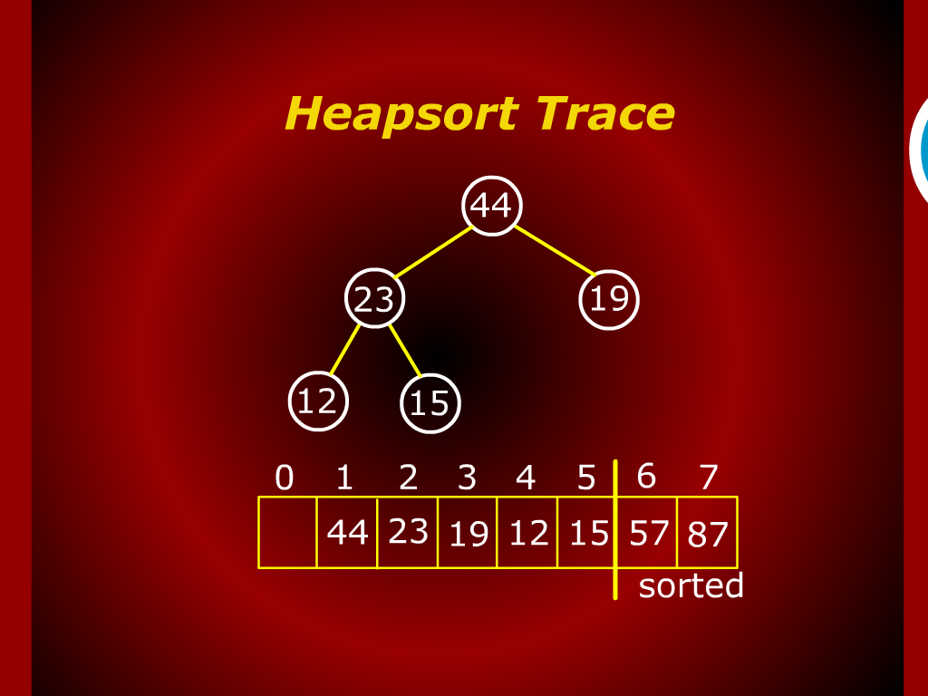
Heap sort Trace

Slide 27
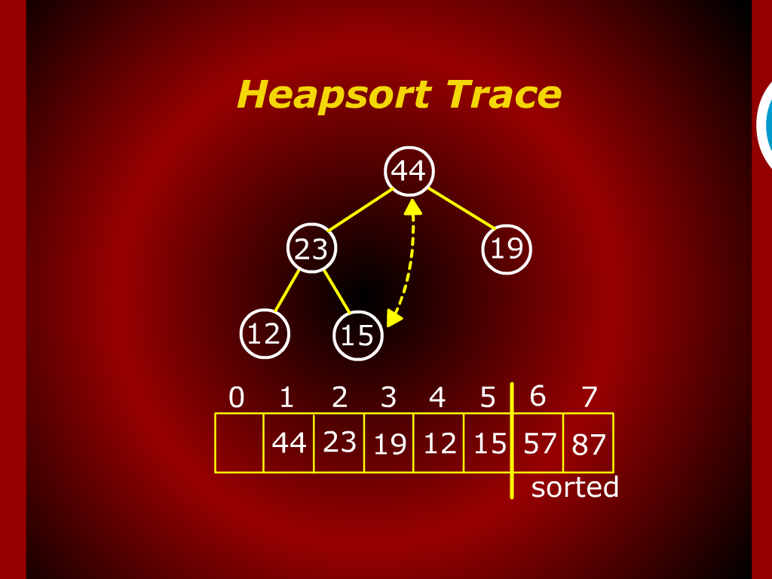
Heap sort Trace

Slide 28
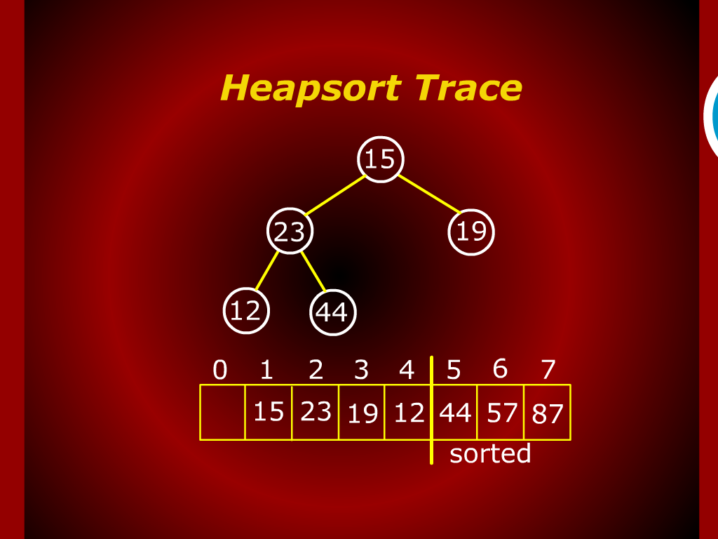
Heap sort Trace

Slide 29
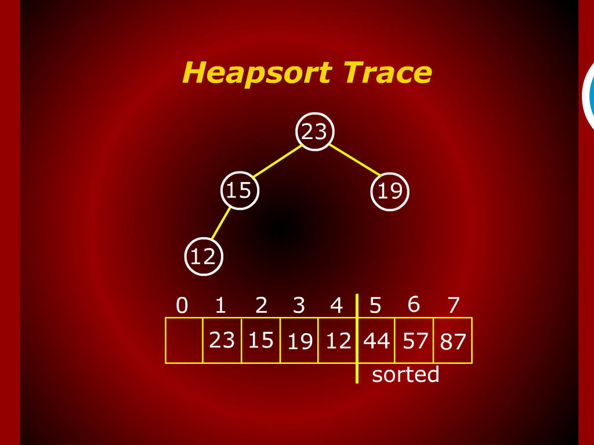
Heap sort Trace

Slide 30
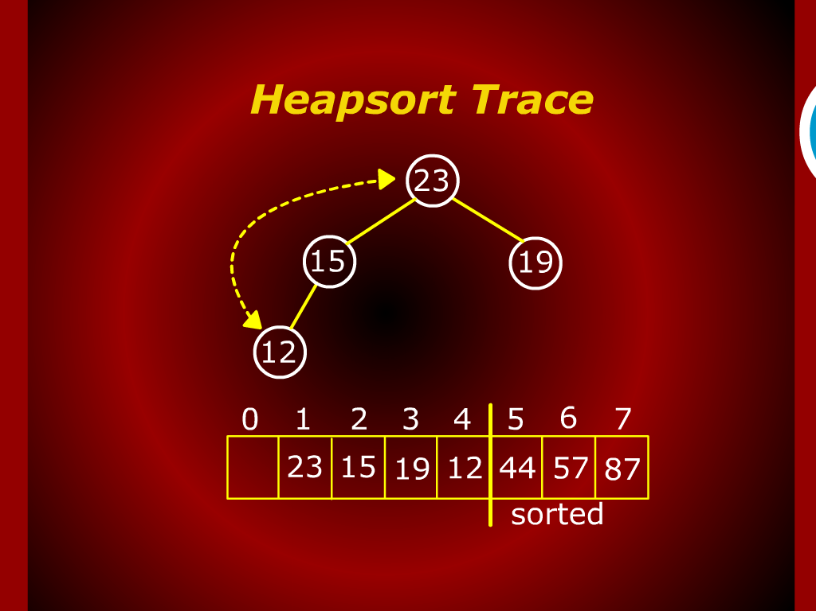
Heap sort Trace

Slide 31
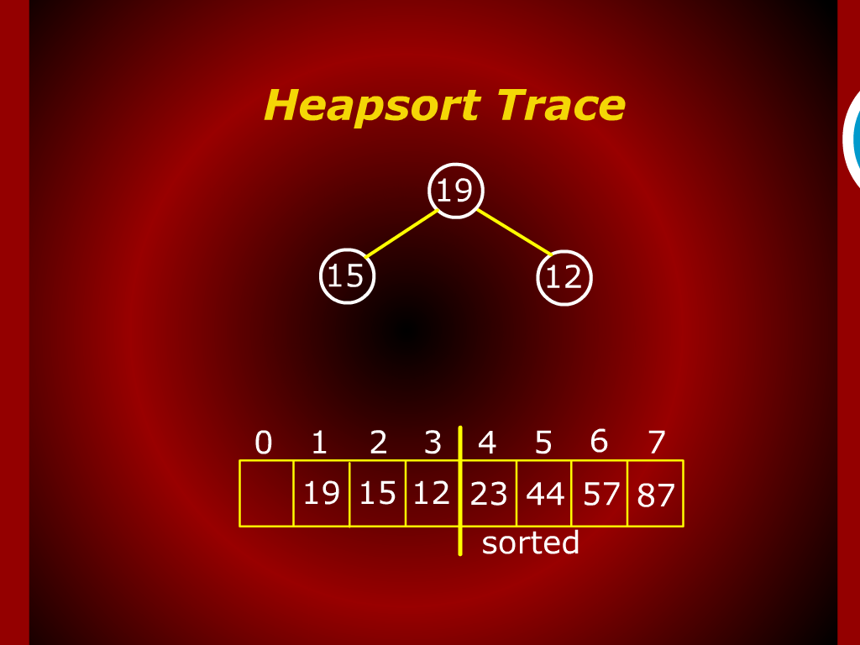
Heap sort Trace

Slide 32
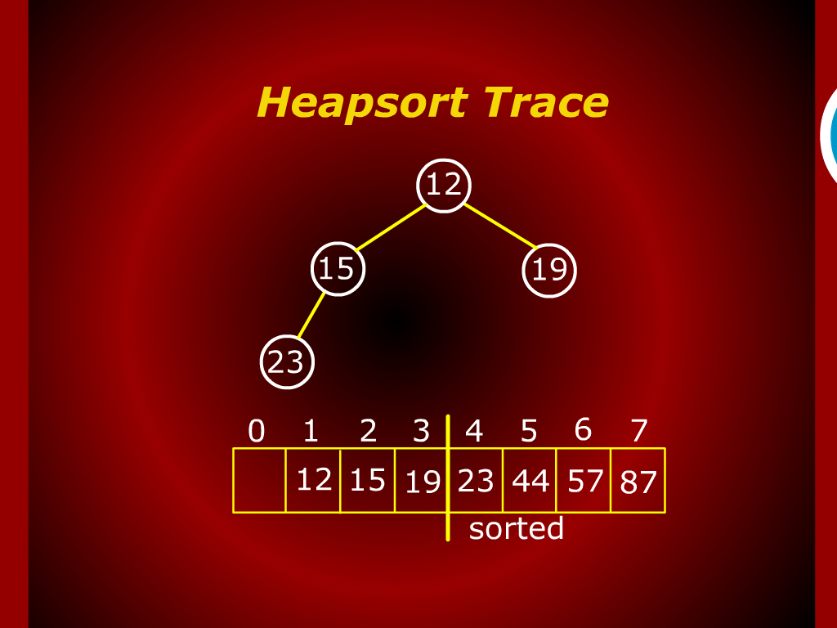
Heap sort Trace

Slide 33
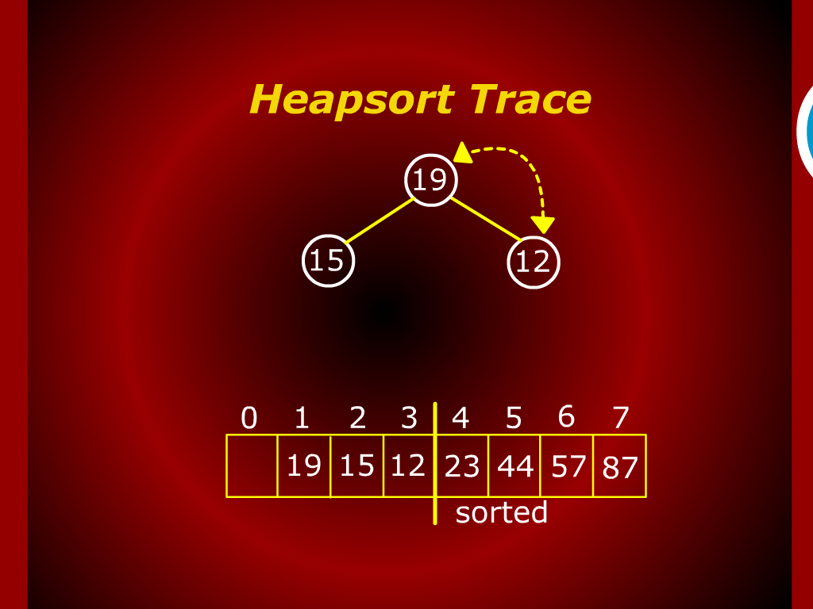
Heap sort Trace

Slide 34
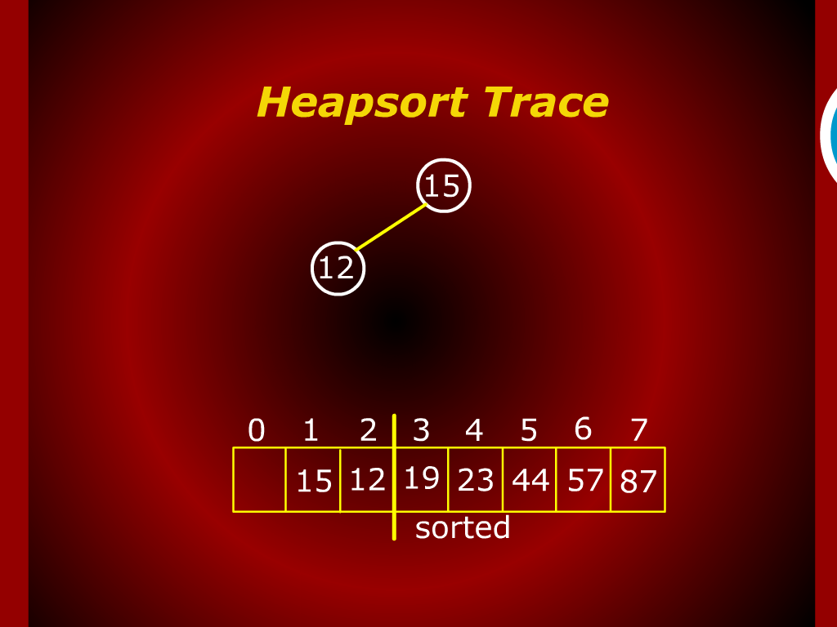
Heap sort Trace

Slide 35
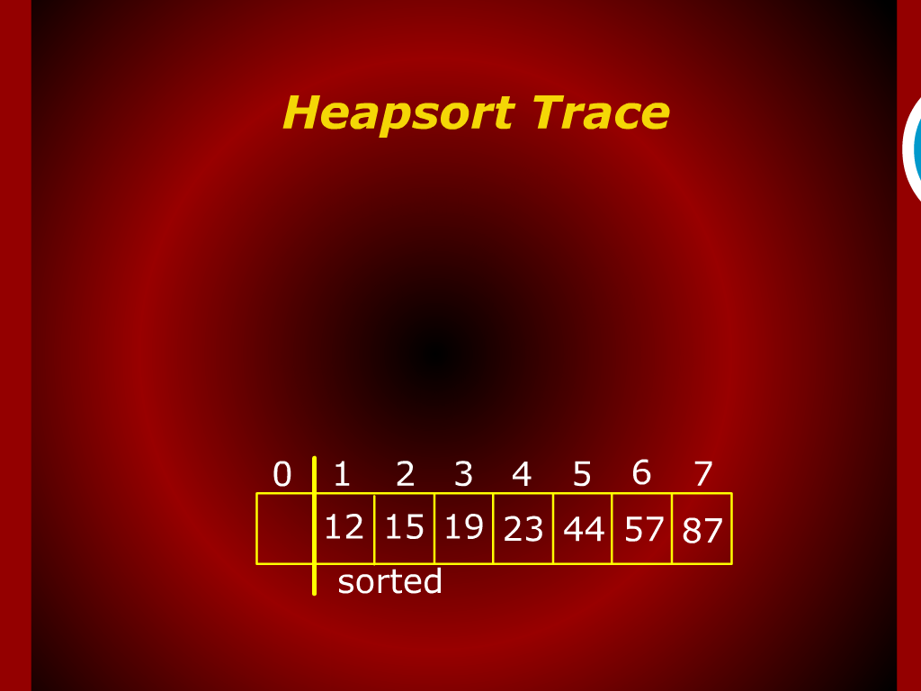
Heap sort Trace

Slide 36
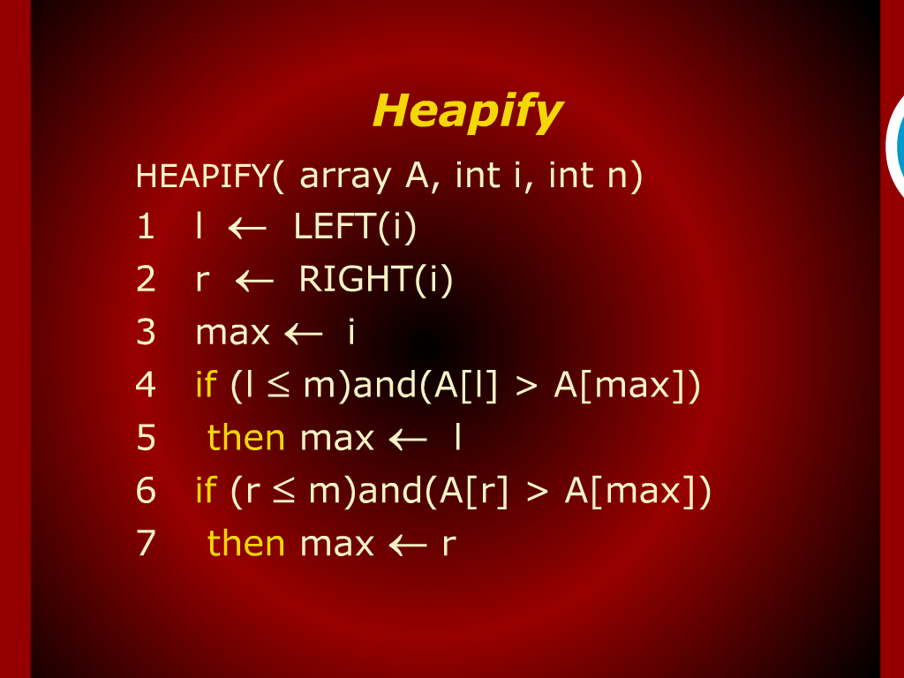
Heapify

Slide 37
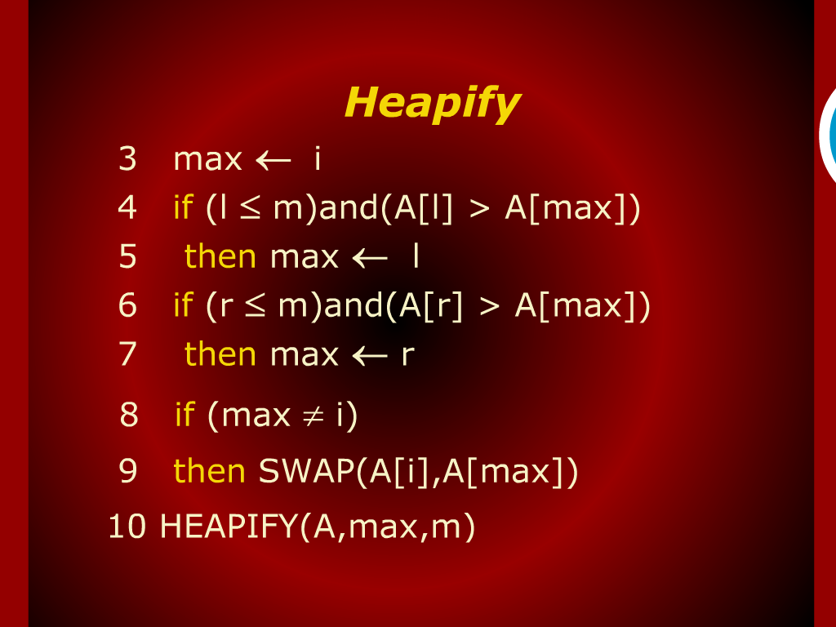
Heapify

